Slide 1

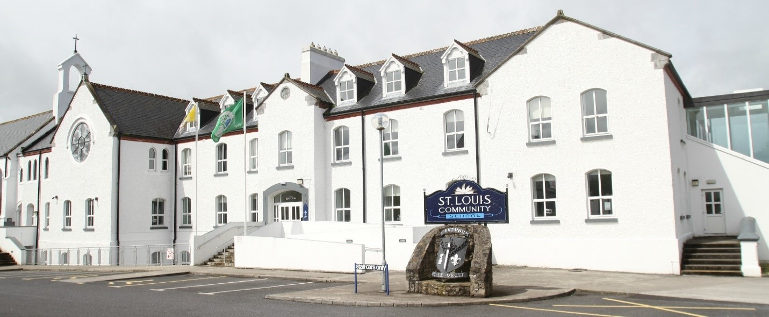
St. Louis Community School
Induction for 1st Year Parents

Slide 2
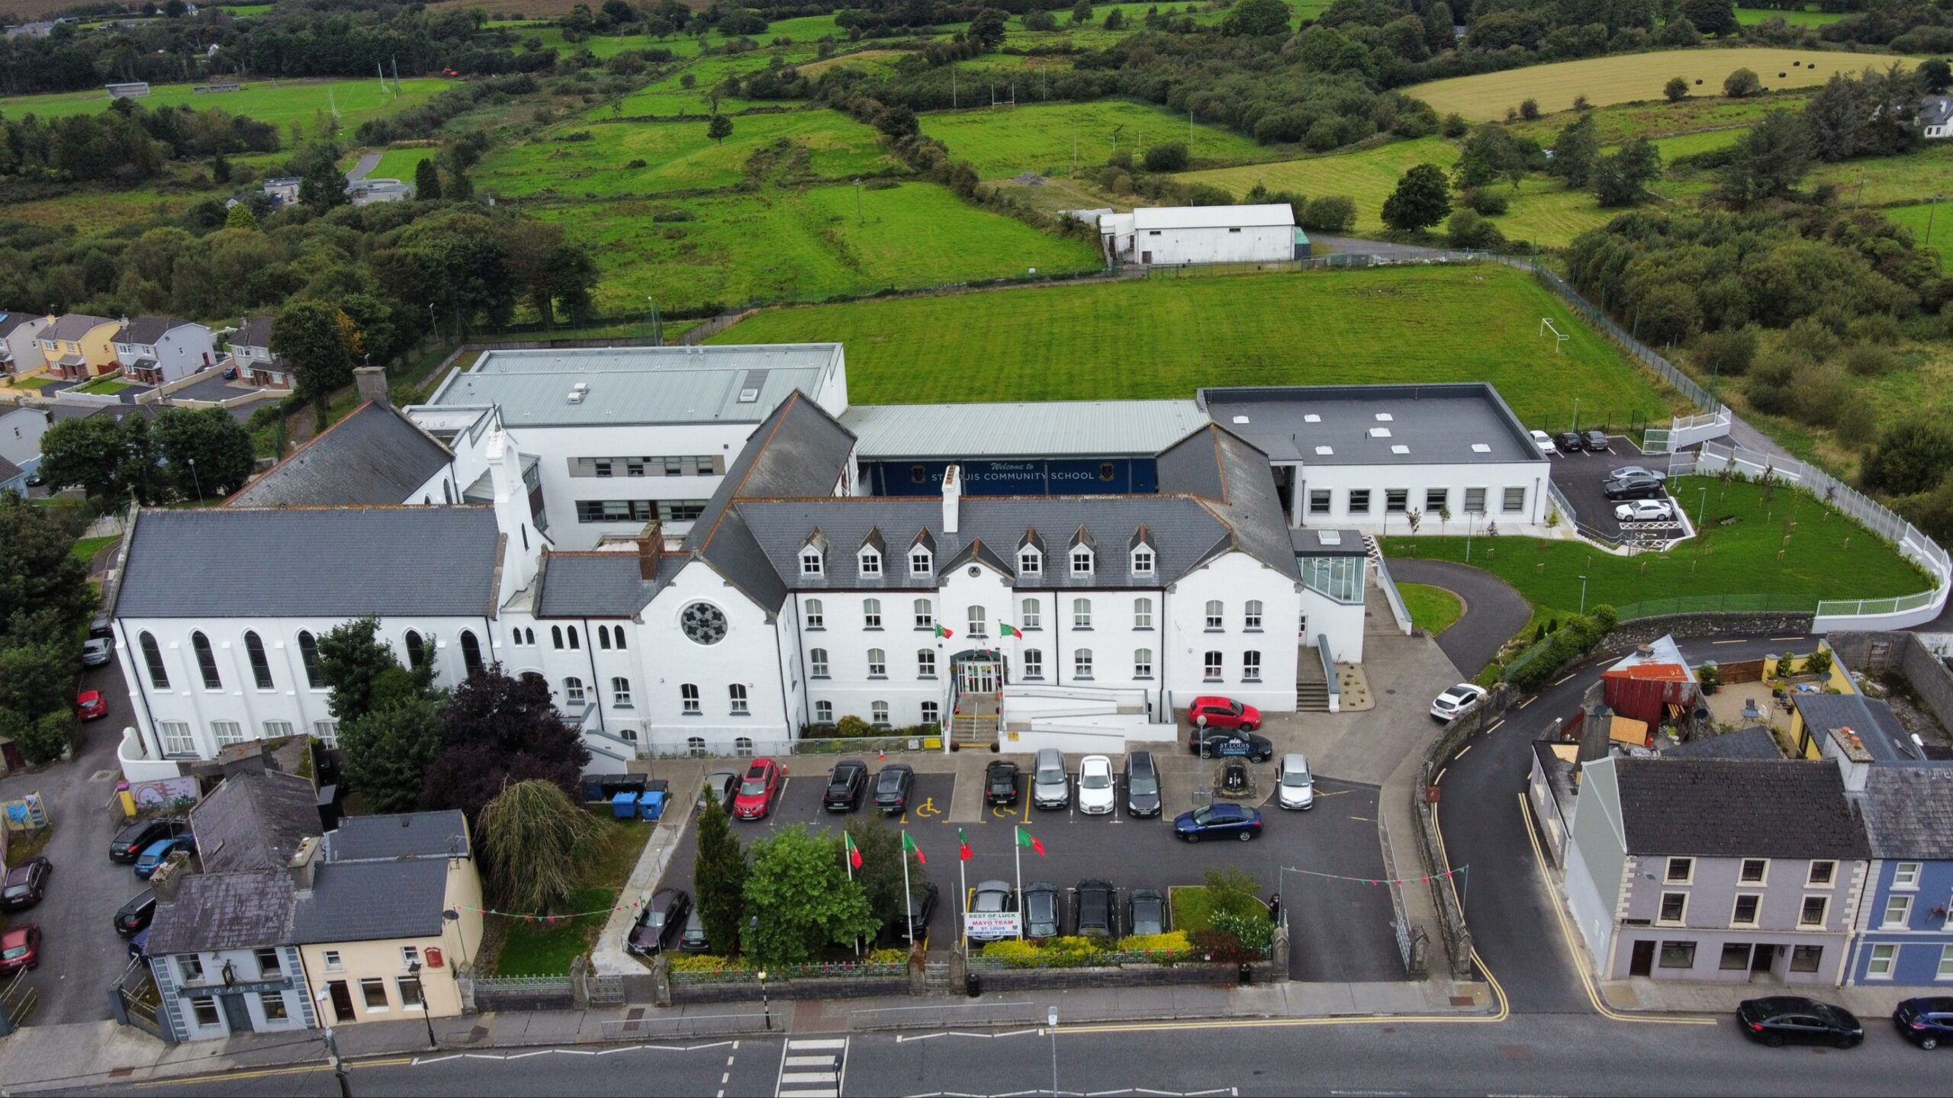
2027
2003
2003
2020
1897

Slide 3
1st Year 2026
115 students
Kiltimagh
Bohola
Kilkelly
Craggagh
Knock
Meelick
Barnacarroll
Claremorris
Midfield
Swinford
Irishtown
Aghamore
Bekan
Taugheen
Lehinch
Meelickmore
Tavneena, Charlestown
Garrymore
Ballindine
Roundfort
Doha

Slide 4
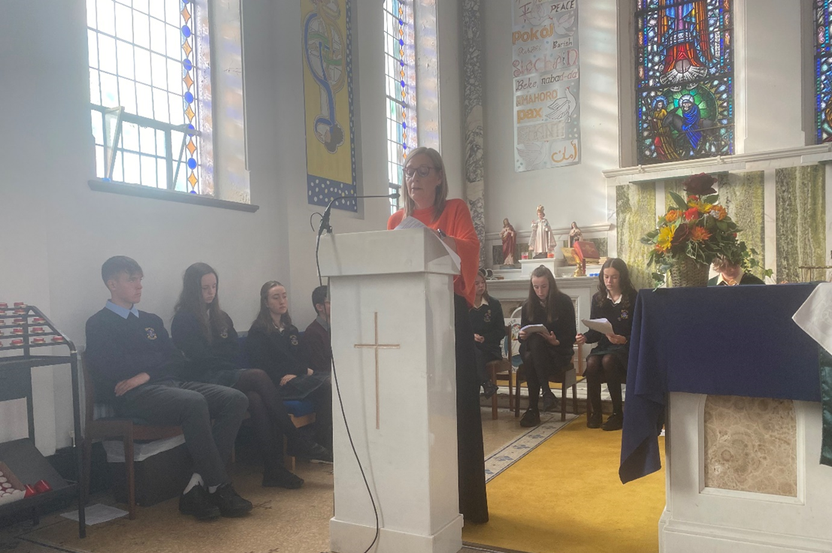
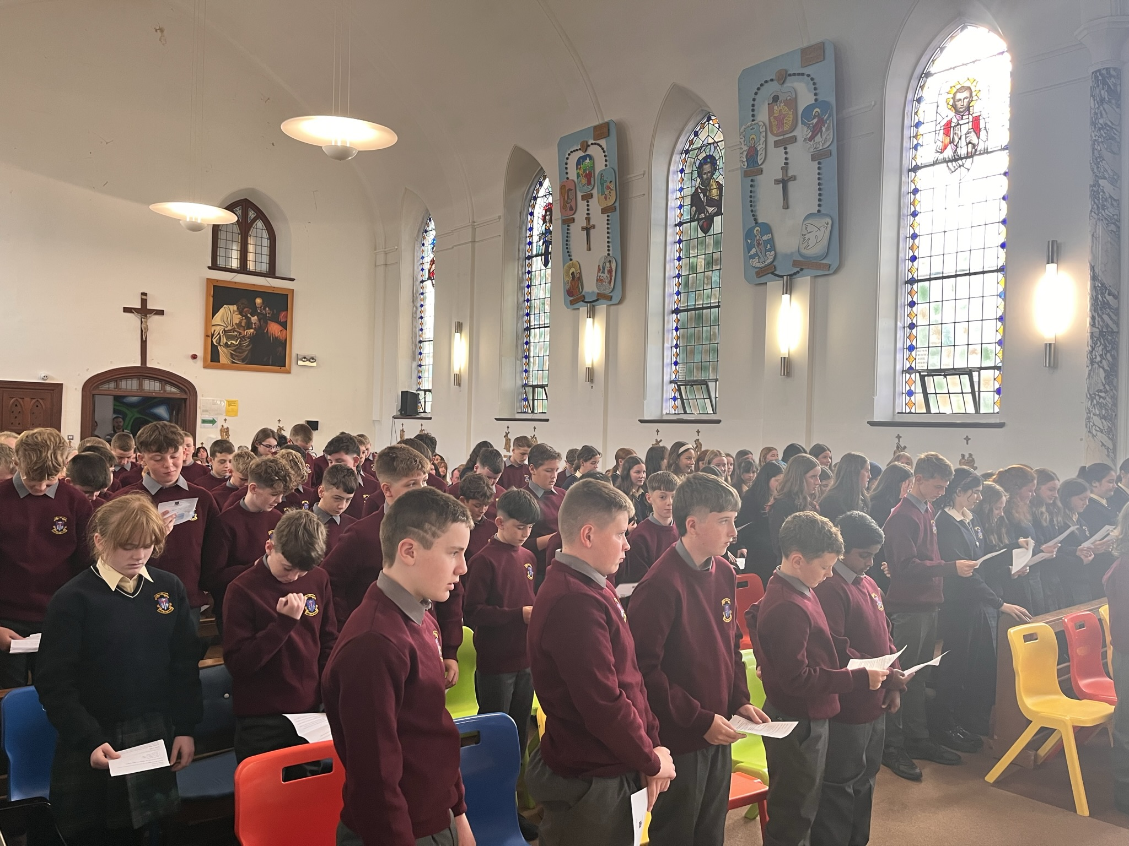
First Day in St. Louis
The first day commences with a welcome ceremony, which lasts about 20 minutes.
Parents / guardians are invited to attend.
After the ceremony, light refreshments
are served to the parents / guardians.
The students will attend an assembly.
Homework Journal
Timetable Treasure Hunt Ice Cream

Slide 5


Opening Times
St. Louis Community School welcomes students from 8.00am.
Breakfast is served from 8.15am to 8.55am and it is free of charge.
Tea and toast
Orange juice
Cereal

Slide 6


Materials Required for the First Day in St. Louis.
School bag
Copy
Biro
Snack for break time or €2.00 for the canteen
Lunch for lunch time or €3.50 for the canteen.

Slide 7


Lighthouse Programme
Our First year students get to take part in the Lighthouse programme,
for one hour every Thursday morning.
Three first year students will be assigned to one fifth year student and the aim of the programme is to help your child to develop friendships and to settle into their new school.
During the Lighthouse class, the students get to enjoy lots of fun activities including jiving lessons, balloon modelling, boxercise, treasure hunts, wellbeing activities, photography lessons, Frenchic classes, problem solving challenges, first aid and team building exercises. (€40.00)
All of our students really enjoy this programme, and they
look forward to it every Thursday morning.

Slide 8
Time | Class
9.00 - 10.00am | Class 1
10.00 - 11.00am | Class 2
11.00-11.20am | Break time
11.20 - 12.20pm | Class 3
12.20 - 1.20pm | Class 4
1.20-2.00pm | Lunch time
2.00 - 3.00pm | Class 5
3.00-4.00pm | Class 6
School Day
These are the class times for Monday to Thursday.
School finishes at 1.20pm every Friday.

Slide 9
Preparing for Post Primary School
School Uniform
Boys
Grey uniform shirt.
Wine uniform round neck jumper with crest.
Dark grey uniform trousers.
Black shoes or runners without coloured branding.

Slide 10
School Uniform
Girls
Navy v neck jumper with crest
Cream, cotton, uniform blouse worn with collar turned down.
Knee-length, pleated, check uniform skirt or navy uniform trousers.
Plain (not embellished), flat, completely black shoes.

Slide 11
No school jacket or PE uniform
Books – Ms. Maloney
School bag – good quality – waterproof
Lunchbox - canteen
Lock for locker – Diamonds Hardware, Kiltimagh.
Label EVERYTHING
Nervous – walk around the school
Special time – enjoy it

Slide 12
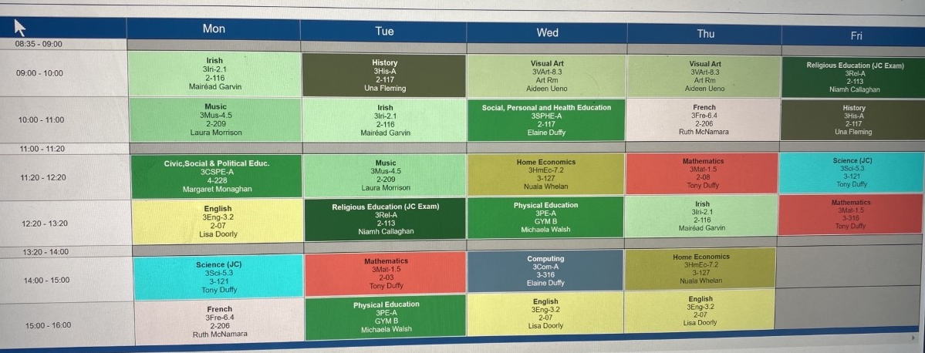
Sample Timetable

Slide 13


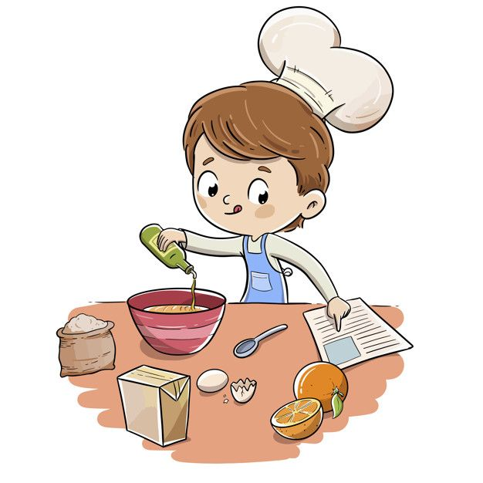
Subjects
All students study the following core subjects
Irish*, English, Maths, Religion, History, SPHE, CSPE, PE, ICT.
All students choose five of the following optional subjects
Home Economics, Music, Art, Geography, Wood Technology, Engineering, Business, French, Spanish, Technology, Science, Graphics
Unless they have an Irish exemption

Slide 14
Changing Subjects
If your son or daughter wants to change their optional subjects, please take the following steps;
The student must make an appointment with Ms. Ruane, she will check the class sizes and see if there is a space available, then she will discuss the implications of the subject change.
The student must bring in a note from their parents or guardians, granting permission to change subject and present it to the DP, who will make the change on TYRO.
She will also inform the relevant subject teachers and the Book Rental coordinator.

Slide 15
Homework Journals
•Students are asked to have their School Journals with them for every class period to record their homework.
•Parents are asked to check that their son / daughter is completing their homework and to sign the Homework Journal.
•The School Journal is to be used only for the recording of homework, and communication between parents/guardians and the school.
We ask students to keep their journals in good condition and free from graffiti.
it must be maintained in a clean condition, free from graffiti etc.
•The loss of a School Journal, or defacing or removing of Journal pages is a serious matter. Where this arises students must present a written explanation of same, signed by parents/guardians, and may be required to purchase a replacement School Journal.

Slide 16
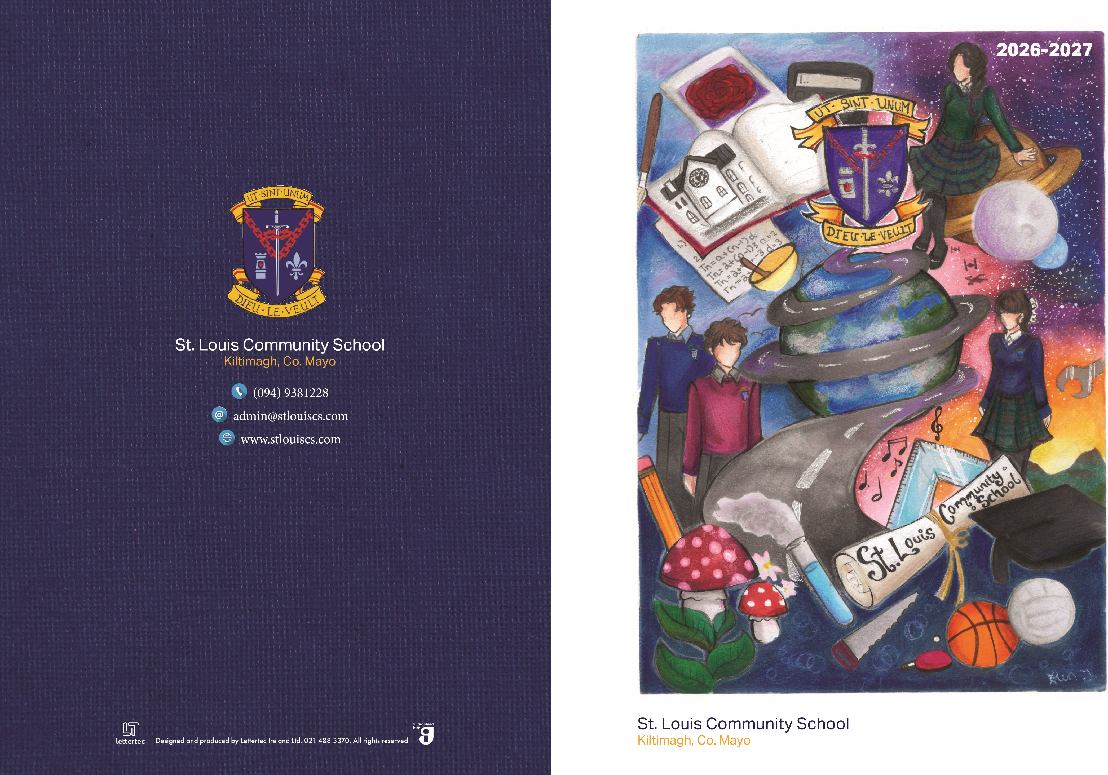

Slide 17

After School Homework Club
The Homework Club starts at 4.15pm and finishes at 5.30pm Monday to Thursday.
Some of the kind ladies in the Homework Club will help your son or daughter to complete their homework and they will get free fruit and a drink.
It is supervised by our team of Special Needs Assistants.
Places are limited.
walburg.ruane@stlouiscs.com

Slide 18
Best Practice
Be organised – check the journal, school bag
Help with the homework
Sign the journal
Check TYRO
Check in
The 1st Yr Year Head for the 2023-2024 academic year is Ms. Ruth McNamara.

Slide 19

After School Evening Study
Evening Study is available to all students from 4.20pm to 6.20pm, Monday to Thursday and 2.00pm to 4.00pm on Friday.
This is a quiet, study facility, students do not get help with their work.
There are costs involved in attending Evening Study.

Slide 20

Assessments
Students will have two sets of formal assessments at
Christmas and the end of the year, they will also have various class tests throughout the year.
Reports.
All student assessment reports will be available on TYRO under the Assessment tab.
If you have any difficulty accessing these reports, please contact the school office on 094 93 81228

Slide 21

School Bags
Schoolbags are extremely heavy in secondary school, if
students don’t use their lockers wisely.
All of our classes are one hour in duration, so the students have a maximum of six subjects in a day. When they come into school in the morning, they should go to your locker and put all of their books into it, except the books that are required for the first two classes.
At break time students should put the books from the first two classes into their locker and take out the books for the next two classes.
After they have eaten their lunch, they should put the books they had for classes 3 and 4 into their locker and take out the books they require for the last two classes.

Slide 22
Attendance
All absences must be accounted for
Explanations via the school app
20 days Education Welfare Officer

Slide 23
Procedures for Students Arriving Late or Leaving Early
If a student arrives late in to school, the parent / guardian accompany them to the main office and sign them in.
If a student has to leave school early, the parent /guardian must sign the child out on the app and call to the main office to collect them.

Slide 24
If your Child feels Sick in school
If your child feels sick and they really cannot stay in school, they tell their class teacher that they don’t feel well, and they want to go home.
They gather their belongings, go the school office and tell Fiona or Imelda that they want to go home. They will ring a parent or guardian to collect them.
The student’s contact numbers are available on our school administration system.
A student cannot leave the school until their parent or guardian collects them from the school office.

Slide 25
Classroom Based Assessments (CBAs)
Timeframe –calendar
Junior Cycle results – SEC
CBA – JCPA

Slide 26
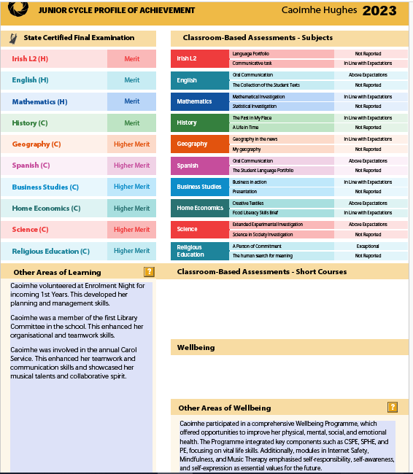

Slide 27
Senior Cycle (Leaving Cert)
Additional Assessment Components (AACs)
Project 40%

Slide 28
5th Year Sept 2025 | Business Biology Chemistry Physics
5th Year Sept 2026 | Construction Studies Engineering Geography LCVP
5th Year 2027 | Agricultural Science DCG History Maths Home Economics Music English ** Accounting **
5th Year Sept 2028 | Art French Gaeilge Spanish
5th Year Sept 2029 | Applied Maths Religion

Slide 29
Book Scheme
All books provided by the school as we are receiving funding from the government.
A deposit of €50.00 per year is required
The schoolbooks will be on LOAN to each student until the end of Junior Cycle.
It is important that schoolbooks are kept in good condition so they can be reused.
Books will be distributed to students before starting school at the end of August.
Books will remain the property of the school.
If books are lost or damaged beyond ordinary wear and tear, they will NOT be replaced by the school.

Slide 30
Stationery
Core classroom resources will also be provided.
Each student will get a stationery pack.
It is important to note that the stationery provided may not fully cover the total stationery and equipment requirements for each subject.
Additional stationery for specific subjects may need to be purchased separately by parents/guardians.
Used or lost stationery is to be replaced by parents/guardians.
The budget is subject to change and so we cannot guarantee the same provision year on year.

Slide 31


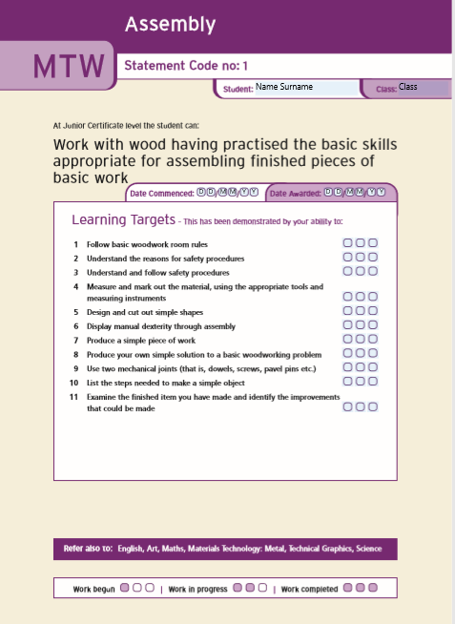
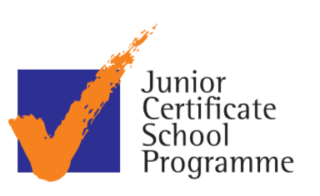
Notes:
Sponsored by the Department of Education and Skills and the National Council for Curriculum and Assessment. It originated in the early school leavers’ programmes initiated by the Curriculum Development Unit. Currently the programme is operating in 226 schools throughout the country
Thanks for work last year

Slide 32
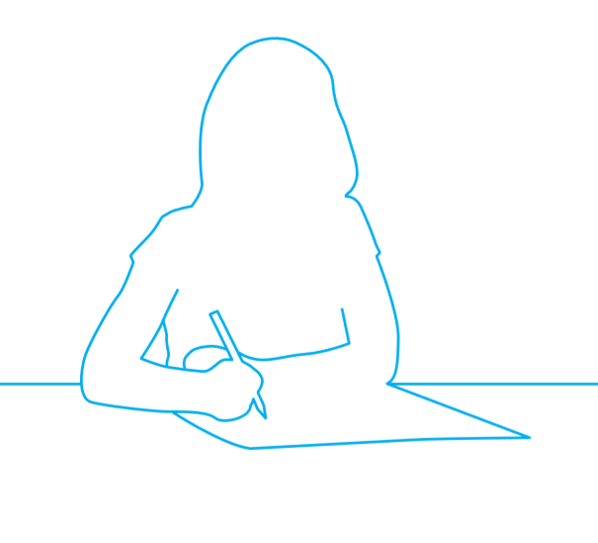
What is JCSP
Junior Certificate Schools Programme (JCSP) is run in conjunction with the Junior Cycle.
Builds basic skills of literacy and numeracy
Improves personal and social skills
Encourage learning
Encourage attendance
Create enthusiasm about school
Helps students have a positive education experience
Notes:
JCSP is a social inclusion programme that is aimed at students who are identified as being at risk of being socially or academically isolated or at risk of early school leaving before the Junior Cycle has been achieved
The JC with a plus
Junior Certificate Schools Programme is run in conjunction with the Junior Certificate.

Slide 33
Criteria for admission to JCSP
Based on;
STEN scores from National School
CAT 4 test results
Recommended by teachers
Social / emotional difficulties
Limited to 45 places – must apply for it.

Slide 34
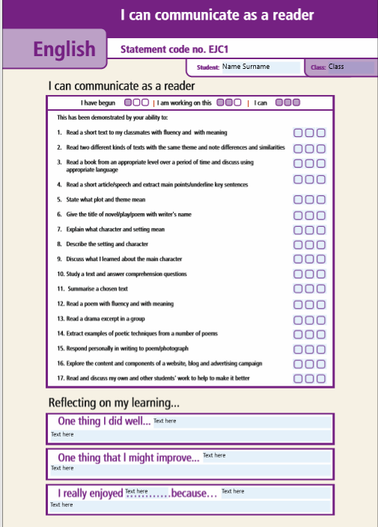
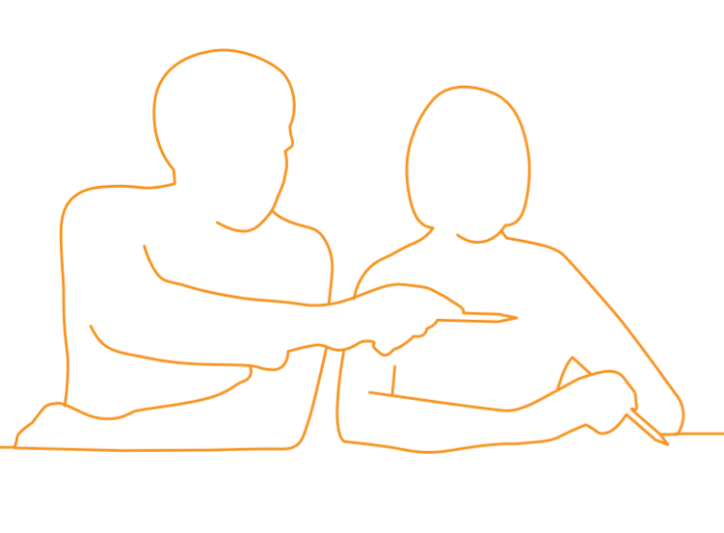
How does the JCSP work?
Statements are used for Student Profiling – Teachers record learning targets students have reached
Encourage students through initiatives
Extra activities
Notes:
1) Literacy Initiatives
B) Storytelling
D) Digital Storytelling
E) Book Review
F) Digital Portfolio
G) JCSP Newsletter / Yearbook
2) Reading Initiatives
A) ‘Who Wants to be a Word Millionaire?’
C) Reading Challenge
D) Reading Challenge Top Up
G) Paired Reading
I) Drop Everything and Read (DEAR)
Pages 3) Numeracy Initiatives
A) School-based Numeracy
B) Number Millionaire
C) Digital Device
4) Subject Specific Initiatives
Gaeilge:
A) Maidin Gaeilge
B) F) Physical Education
G) Dance (incl Ceili)
K) Field Trip
L) History
M) Geography
N) Music
O) Home Economics
P) Home Economics: Celebrity Chef
Q) Subject Topic Boxes
Pages 5) Digital Technology Initiatives
A) Digital Storytelling
B) Digital Portfolio
D) Film Making
E) Digital Technology in the Classroom
6) STEAM Initiatives
A) Science
B) Materials Technology Wood
C) Materials Technology Metal
D) Technical Graphics
E) Junior Cycle Coding in Action
F) Artist in the Classroom
G) Trip to an Art Gallery
H) Arts in Junior Cycle
I) Paired Maths
J) Maths Games
K) Maths Laboratory
26-28
7) Key Skills of Junior Cycle Initiatives
A) Being literate
B) Managing myself
C) Staying well
D) Managing information and thinking
E) Being numerate
F) Being creative
G) Working with others
H) Communicating

Slide 35
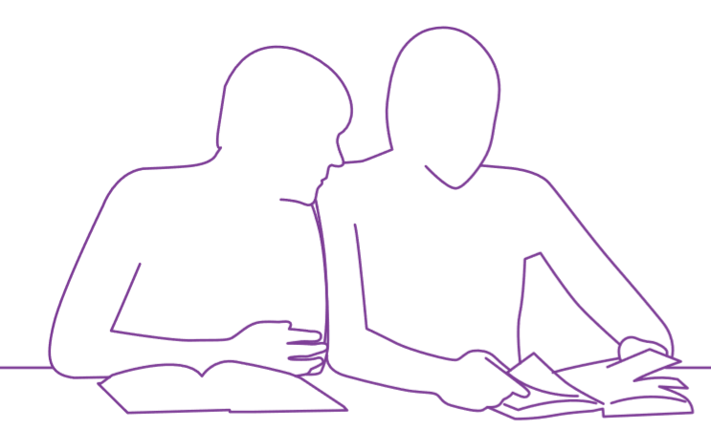
Initiatives:
Different initiatives each year
Subject Specific (Home Economics, Celebrity Chef, Field Trips)
Literacy (Digital Portfolio)
Reading (Who Wants to be a Word Millionaire)
Numeracy
STEM (Lego education)
Digital Technology
Wellbeing - Rewards (Bowling)

Slide 36
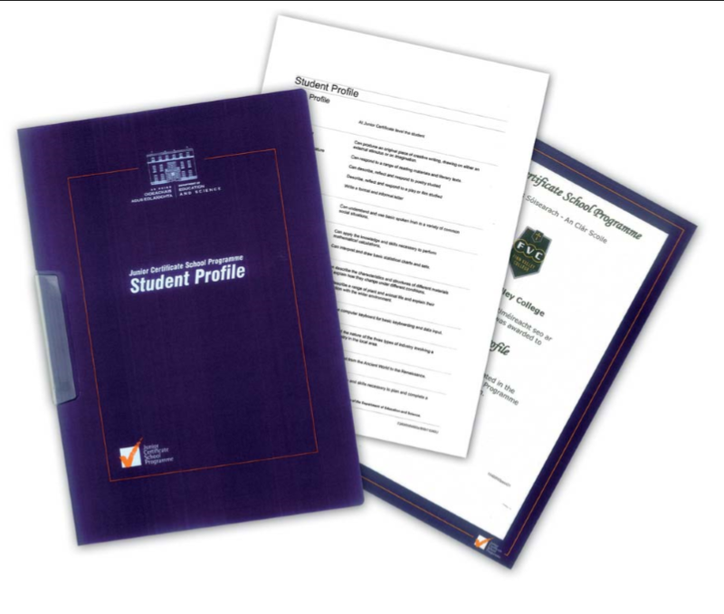
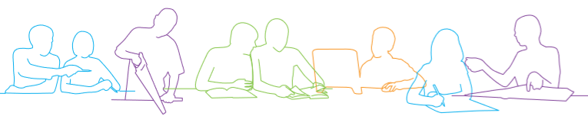
On Completion
Each Student will receive an additional Certificate at the end of Third Year along with their Junior Cert results
Students receive a reference
Celebration
Notes:
The Junior Certificate School Programme aims to provide a curriculum framework that assists schools and teachers in making the Junior Certificate more accessible to those young people who may leave school without formal qualifications. It attempts to help young people experience success and develop a positive self-image by providing a curriculum and assessment framework suitable to their needs. On completion of the programme students receive a profile which is an official record of their achievements from the Department of Education and Skills.

Slide 37

School Supports

Slide 38

What Support looks like in our school
Year Head
Class teachers
Deputy Principal – additional - September
Principal
Chaplain
2 Career Guidance teachers
Lighthouse tutors
Prefects
School Counsellor

Slide 39
Anxiety
Friendship issues
Home issues
(CP)
Illness
Bereavement
Personal issues
Learning difficulties

Slide 40
Support in school
Counselling outside of school
Youth Diversion Project
Home tuition
Meitheal of services
Foroige Youth worker

Slide 41
Support for Students with Additional Needs
SNA Support: Exempt Irish Classes:
Classroom support:
Cooperation teaching:
JCSP-Junior Cert Schools Programme-
Withdrawing students:
Additional supports:
The Homework Club:
Catering for students with emerging needs:

Slide 42

Remember...
It takes time for all 1st years to settle into secondary school. It's a big transition for everyone!
tracey.kenny@stlouiscs.com

Slide 43
Pastoral Care Supports
If your child requires emotional support in school, please contact any of the following;
Name | Role | Email Address
Ms. Walburg Ruane | Guidance Counsellor | Walburg.ruane@stlouiscs.com
Ms. Trish O'Brien | Chaplain | Trish.obrien@stlouiscs.com
Ms. Tracey Kenny | Guidance Counsellor | Tracey.kenny@stlouiscs.com
Mr. Fearghal O'Hara | Support Teacher | Fearghal.ohara@stlouiscs.com
Ms. Mary Kilcoyne | Counsellor | mary.kilcoyne@stlouiscs.com

Slide 44
Student Supports outside of School​
Venue | Service | Telephone Number
Mindspace | Mental Health Service | 086 1844995 0949367001
Knock Counselling Centre | Counselling service for 12-18 year olds. | 094 9375032
Family Centre, Castlebar | Counselling, Bereavement Support | 094 9025900
Pieta House, Tuam | Suicide and Self-Harm Crisis Centre. | 093 25586

Slide 45

School Rules
Protect everyone
Policies – school website www.stlouiscs.com
Code of Behaviour
Acceptable Usage Policy
Mobile Phone Policy

Slide 46
Mobile Phones
Must be turned off and out of sight at all times, otherwise they are confiscated until Friday after school.
Please see our mobile phone policy on the school website, for more details.
www.stlouiscs.com
Our School
Policies.

Slide 47

TYRO
TYRO is our school administration system.
Accounts are now set up
Click on your child’s name
Or
Three dots on left to view
depending on the phone
Any issues email
Fiona.byrne@stlouiscs.com

Slide 48

Microsoft Office
All of our students will be set up with a Microsoft Office 365 account and they will have access to Word, Excel, PowerPoint, OneNote email and Teams.
Our ICT Acceptable Usage Policy is developed to guard the use of these facilities, it is available on the school website.
www.stlouiscs.com
Our School
Policies

Slide 49

Medical Issues
If your son or daughter has any medical issues, please inform us immediately by telephoning 094 93 81228
A letter will be required from your doctor, detailing the medical condition and any prescribed medication.
A medical form will also have to be completed, via the school app.

Slide 50

Procedures for Parent Teacher Meetings
All Parent Teacher Meetings will take place in the new building, in the Louis Bautain hall and the classrooms upstairs.
School will finish at the earlier time of 3.45pm on the afternoon of the Parent Teacher meetings. School buses will be notified of the early finishing time.
The meetings will take place between 4.15pm and 6.45pm
Please bring a biro and a list of your child's teachers with you.
Please make every effort to attend your child's
meeting.

Slide 51
Contacting Teachers
All contact with our teaching staff must be by appointment only.
An appointment can be made by contacting the Administration Office on 094 94 81228

Slide 52
School Payments
All school payments can be made via the school app
Open the school app.
Go to the three lines at the top left-hand side of the screen.
Scroll down to shop.
The payment will appear here.
Please ensure all payments are paid in full before school commences.
€80.00 + €40.00 (Lighthouse) = €120.00
Book deposit €50.00

Slide 53
School Canteen
The canteen is open at break time and lunch time every day.
All the dinners cost €3.50 …..SUBSIDY
Welcome to bring their own lunch

Slide 54
School Contact Details
Telephone; 094 93 81228
Email
Principal: Ms. Regina Anderson regina.anderson@stlouiscs.com
Until Friday 24th April.
Deputy Principal: Mr. Grahame Cleary grahame.cleary@stlouiscs.com
Secretary: Ms. Fiona Byrne fiona.byrne@stlouiscs.com
Secretary: Ms. Imelda Reilly imelda.reilly@stlouiscs.com

Slide 55



Social Media
We have a Facebook, Twitter and Instagram page, please follow us on the various social media platforms to keep up to date with all the latest news.
Please find the links or handles below,
Facebook: St. Louis CS
Instagram: stlouiscs_mayo
Twitter: StLouiscs_Mayo

Slide 56
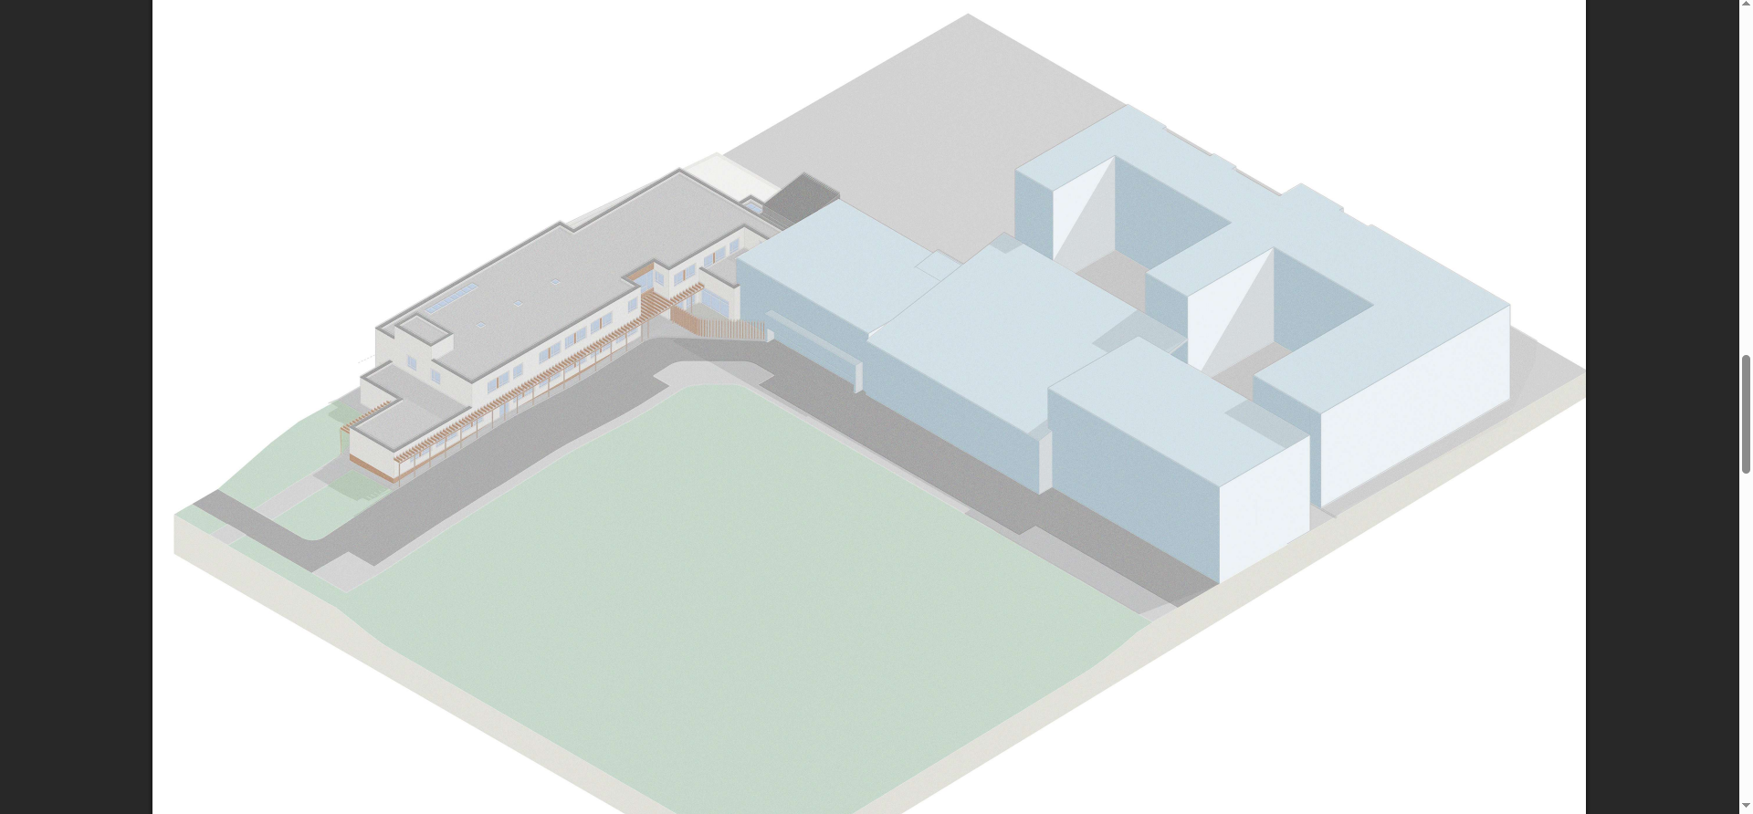

Slide 57
