Slide 1

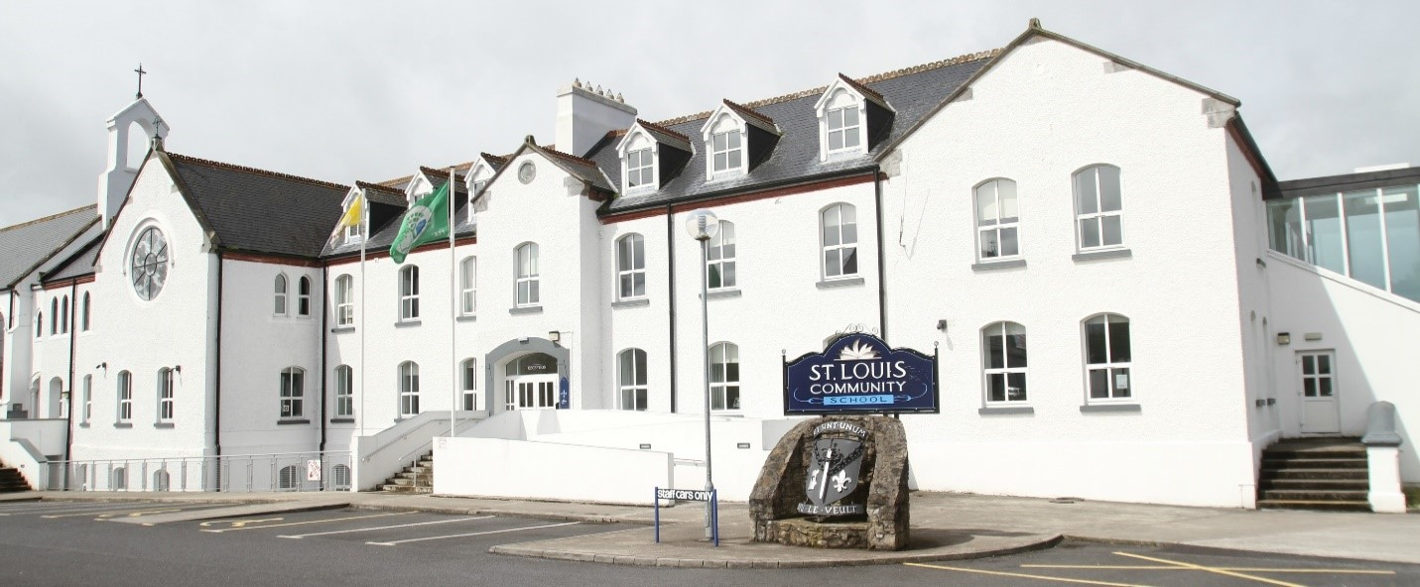
St. Louis Community School
Parent’s eBook for Incoming
1st Year Students.

Slide 2
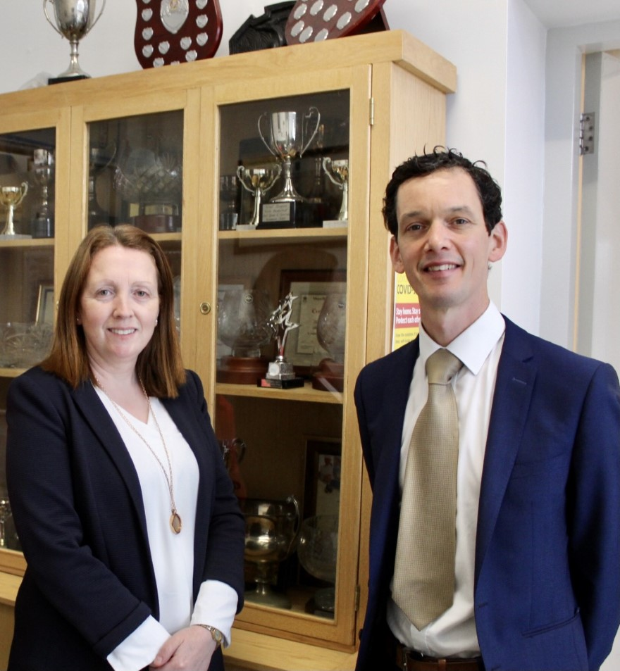
Welcome
On behalf of the entire school community, we extend a warm welcome to you and your child, and I hope you will find this eBook both useful and informative,
St. Louis Community School is a vibrant school, and our team of dedicated staff work together to create an inclusive and successful learning environment where everyone feels happy, safe, respected and valued.
We promote a positive culture, and the values of kindness and respect are at the heart of everything we do.
Wishing you all the best as you embark on a wonderful educational journey with us,
Yours sincerely,
Ms. Regina Anderson Mr. Grahame Cleary
Principal Deputy Principal

Slide 3


Opening Times
St. Louis Community School welcomes students from 8.00am.
Breakfast is served from 8.15am to 8.55am and it is free of charge.
Tea and toast
Orange juice
Cereal

Slide 4
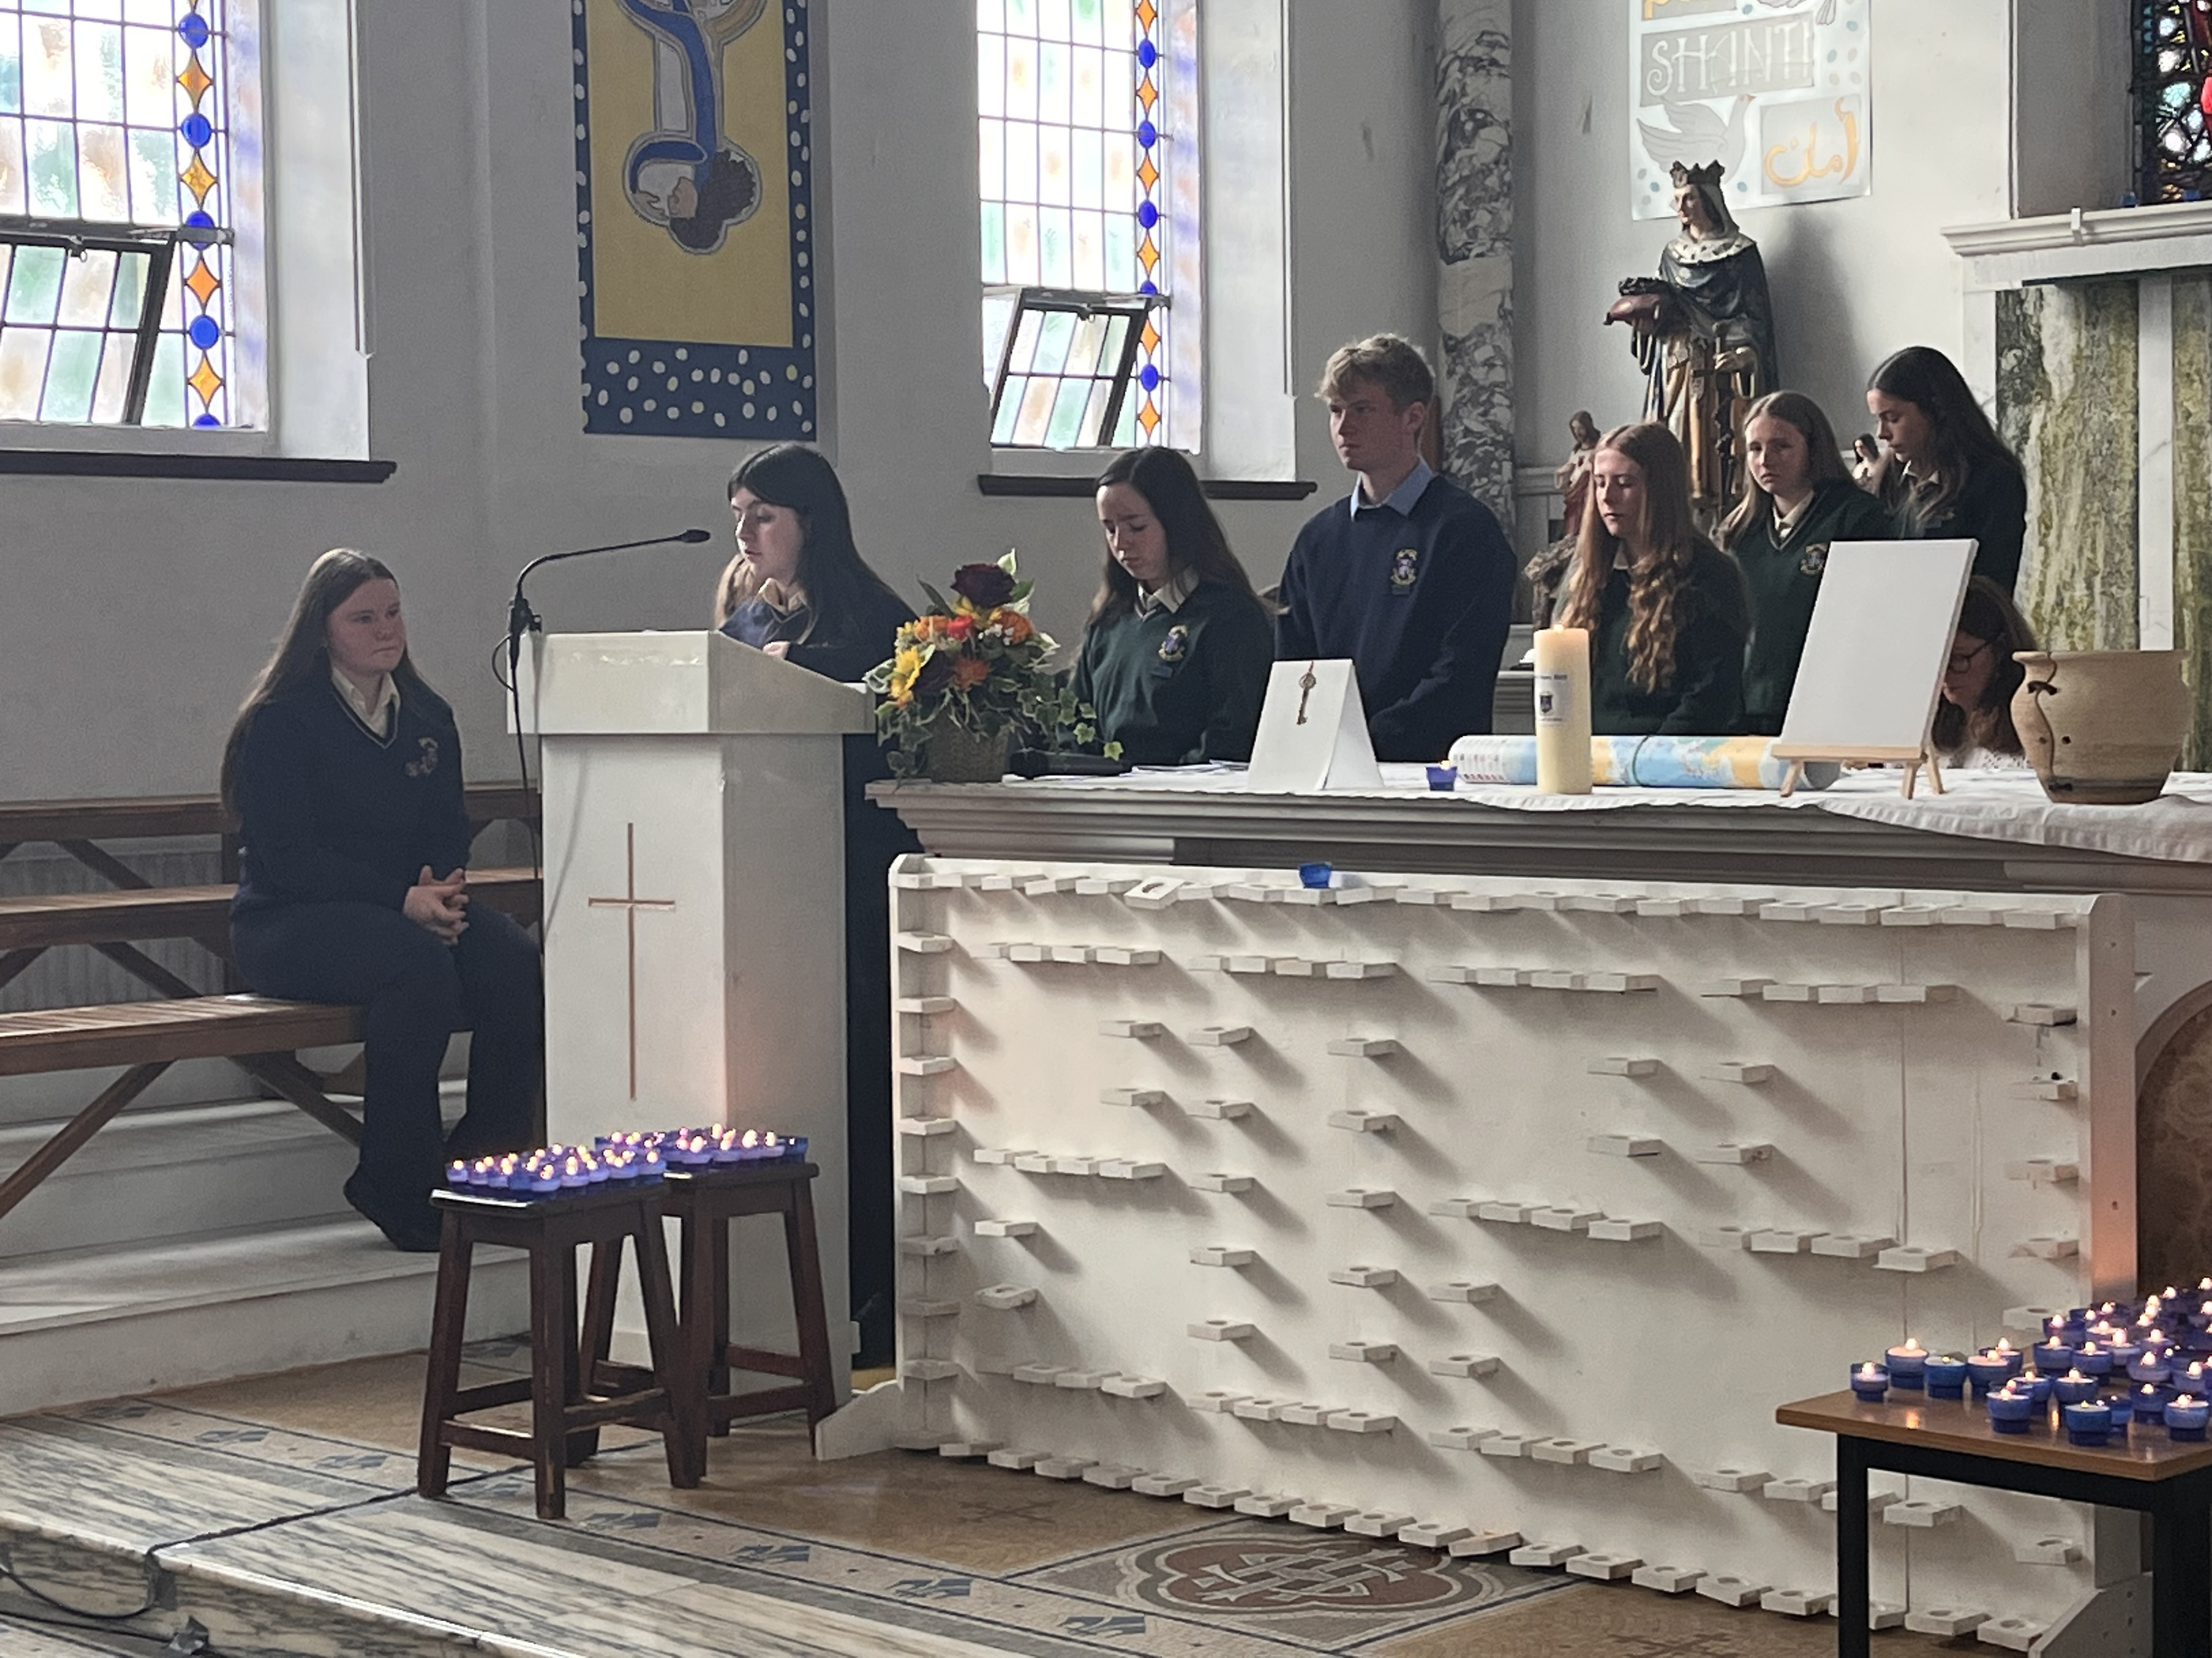
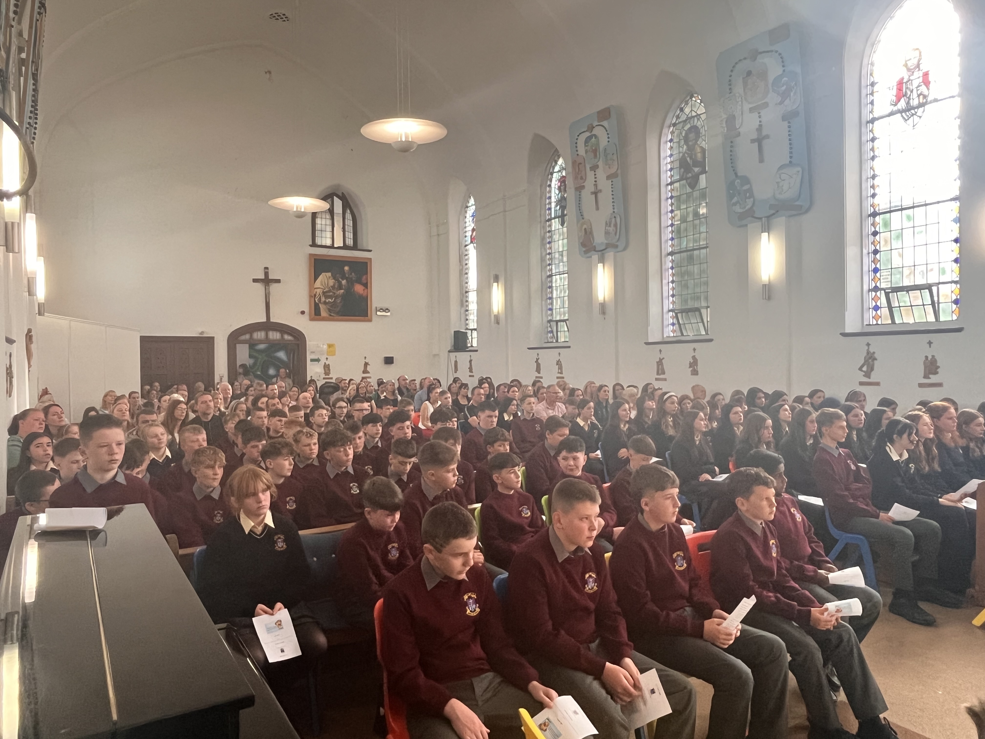
First Day in St. Louis
The first day commences with a welcome ceremony, which lasts about 20 minutes.
Parents / guardians are invited to attend with their son / daughter.
After the ceremony, light
refreshments are served to the
parents / guardians.
The students will attend an assembly.

Slide 5
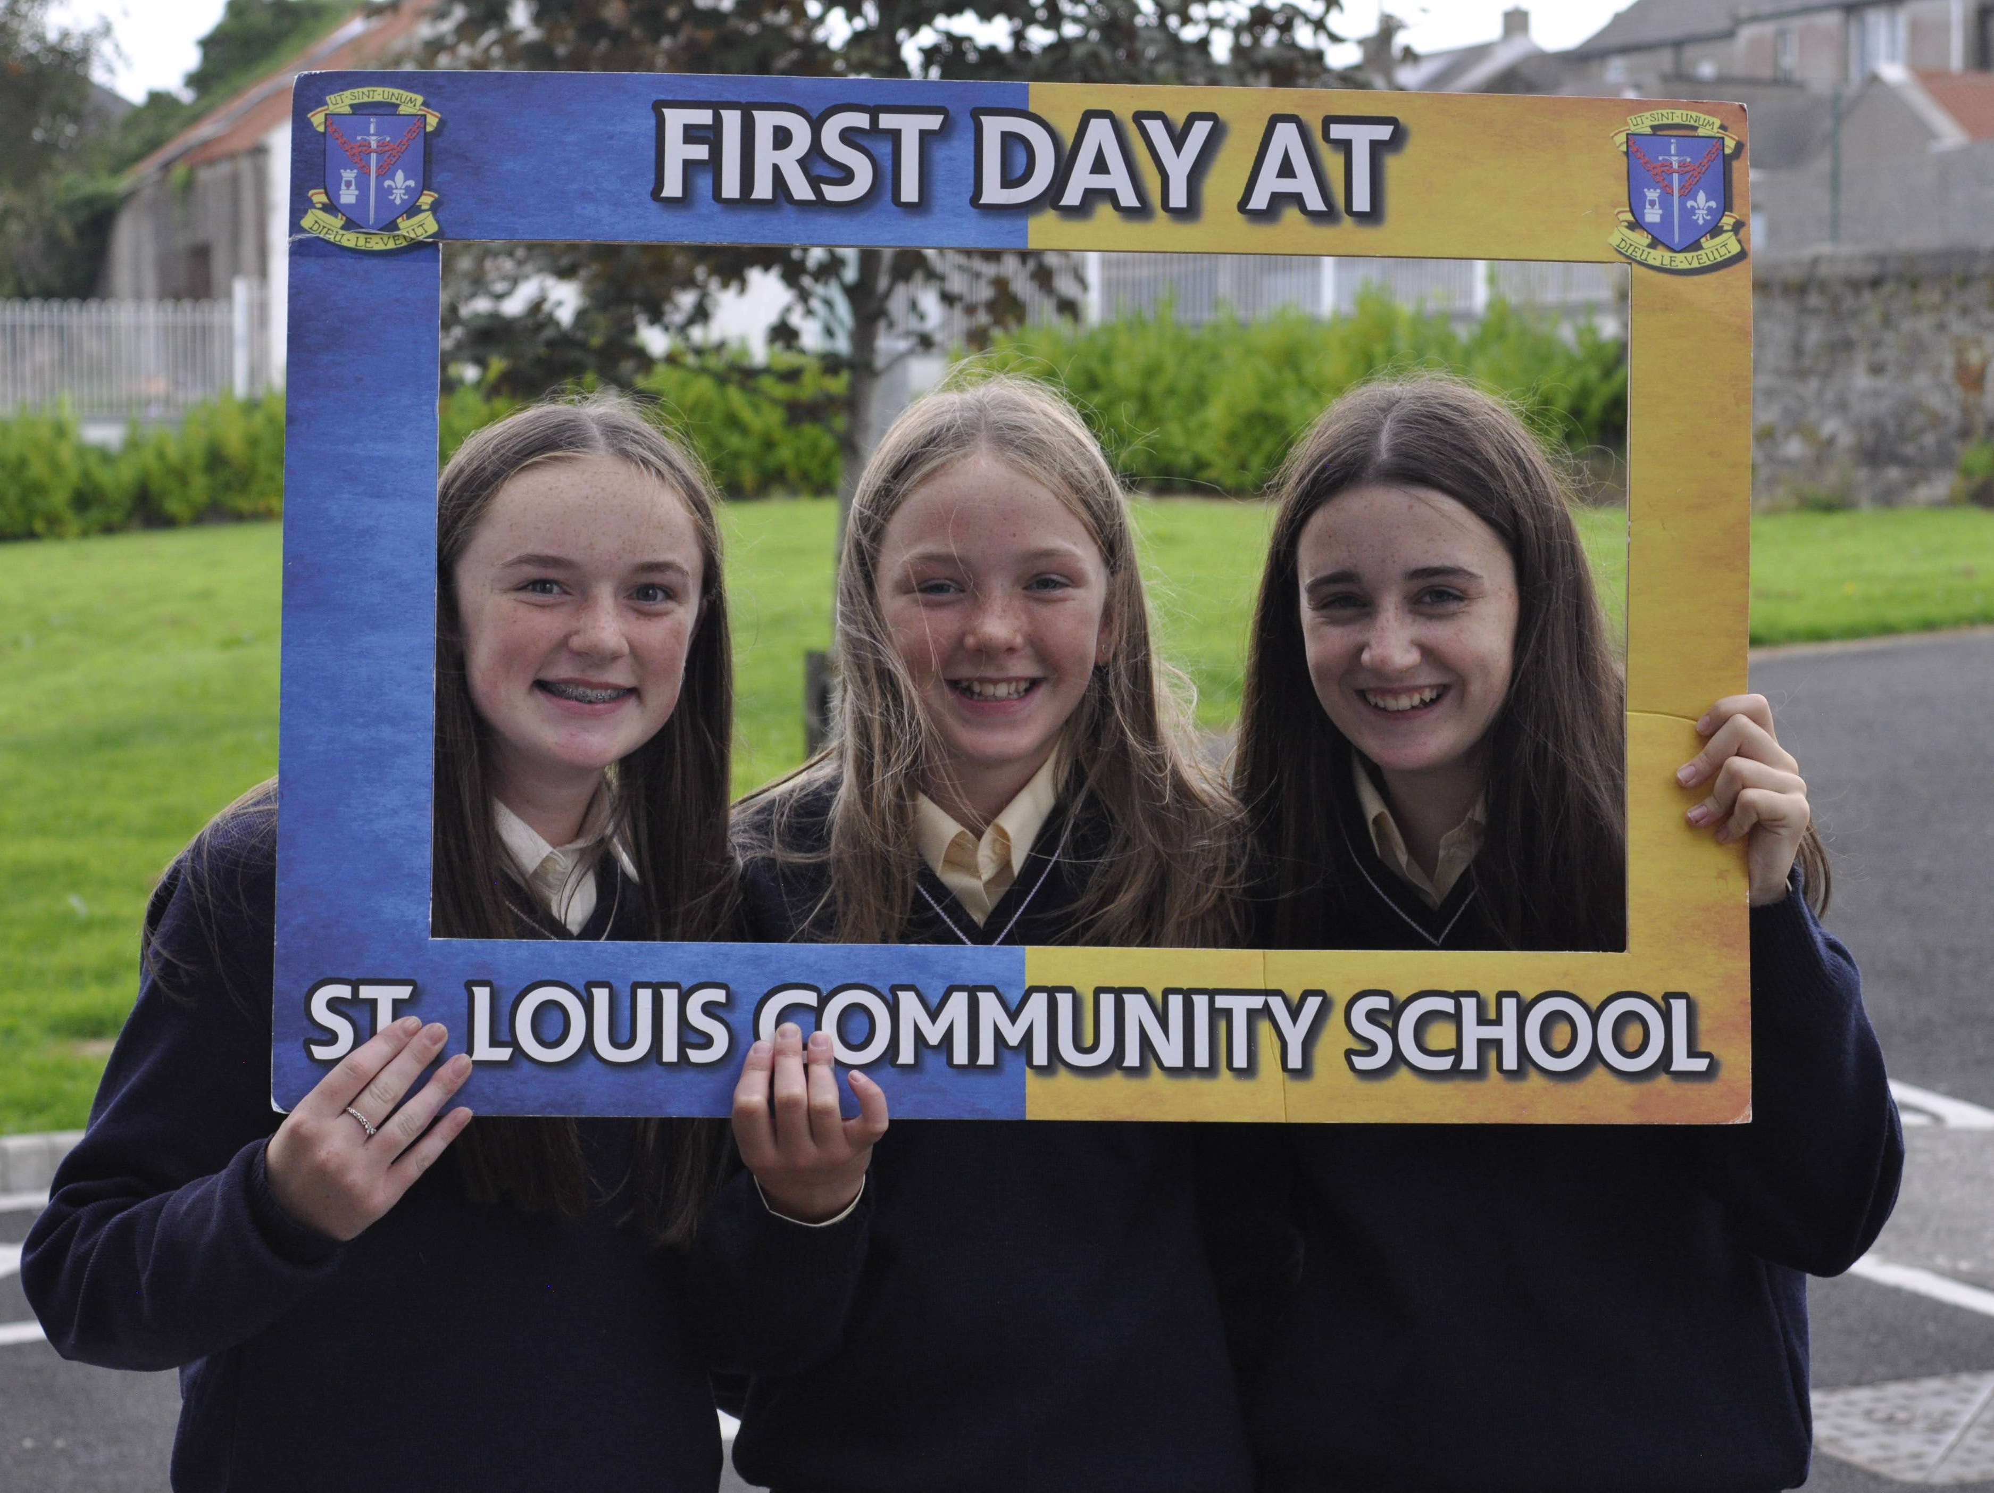
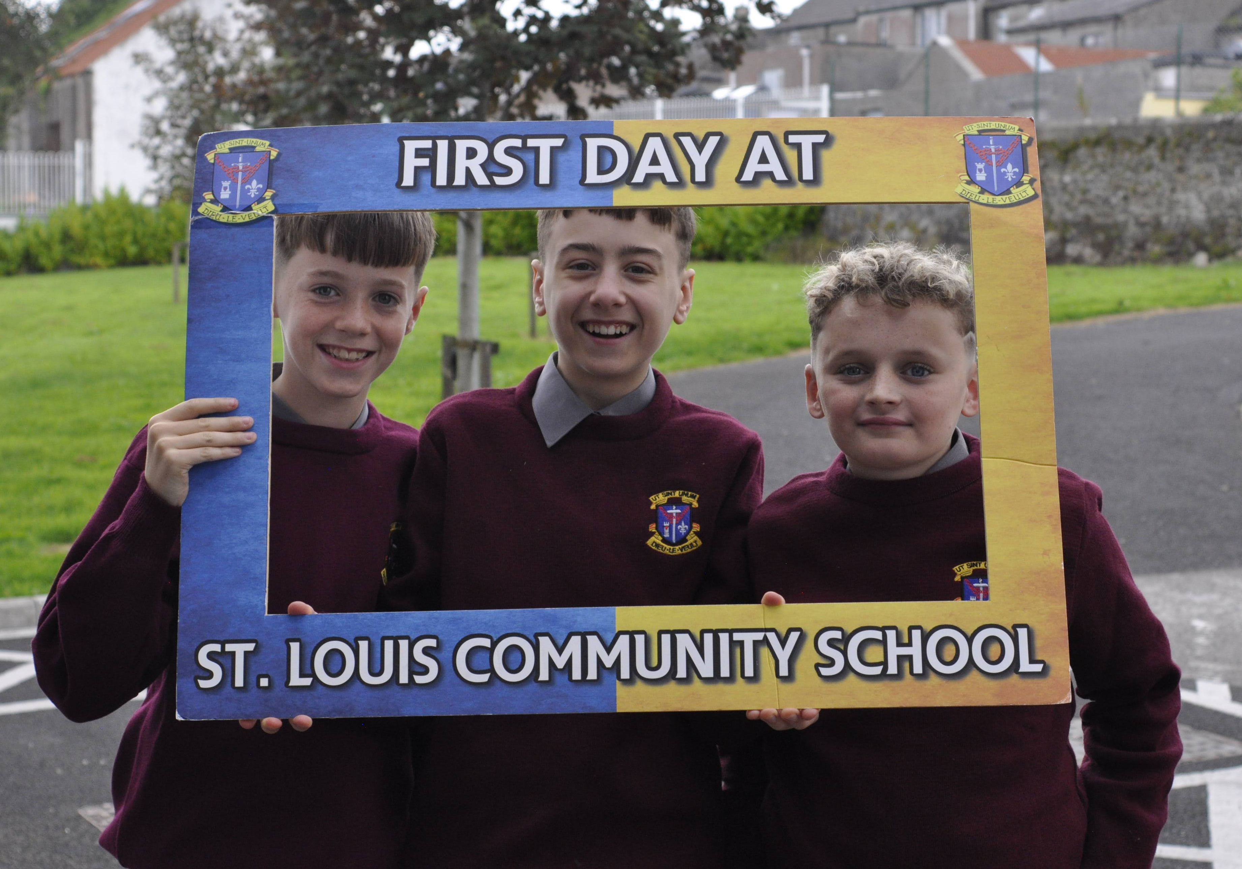
At the assembly, the students will be given the schedule for the day, and we will answer any questions they may have. The students will then be divided into the various class groups.
When they go to class, they will get a homework journal, and their teacher will explain how to use it.
They will receive their timetable, which will also be explained in detail.

Slide 6
Later in the day the students will be assigned a locker and they will receive all the books they need for the year.
The Prefects will help the students to sort out the books for all the different subjects and they will help them to organise them in their locker. ​
​
We will be taking your child's photo at some stage during the first day, this will be used to identify him / her on the school administration system.
The students will get a tour of the school and if time permits, they will get to take part in a treasure hunt.

Slide 7



Subjects
All students study the following core subjects
Irish*, English, Maths, Religion, History, SPHE, CSPE, PE, ICT.
All students choose five of the following optional subjects
Home Economics, Music, Art, Geography, Wood Technology, Engineering, Business, French, Spanish, Technology, Science, Graphics
Unless they have an Irish exemption

Slide 8


Materials Required for the First Day in St. Louis.
School bag
Copy
Biro
Snack for break time or €2.00 for the canteen
Lunch for lunch time or €3.50 for the canteen.

Slide 9


The Lighthouse Programme
Our First year students get to take part in the Lighthouse
programme, for one hour every Thursday morning.
Three first year students will be assigned to one fifth year student, and the aim of the programme is to help your child to develop friendships and to settle into their new school.
During the Lighthouse class, the students get to enjoy lots of fun activities including jiving lessons, balloon modelling, boxercise, treasure hunts, wellbeing activities, photography lessons, Frenchic classes, problem solving challenges, first aid and team building exercises.
All of our students really enjoy the Lighthouse programme, and
they look forward to it every Thursday morning.

Slide 10
Time | Class
9.00 - 10.00am | Class 1
10.00 - 11.00am | Class 2
11.00-11.20am | Break time
11.20 - 12.20pm | Class 3
12.20 - 1.20pm | Class 4
1.20-2.00pm | Lunch time
2.00 - 3.00pm | Class 5
3.00-4.00pm | Class 6
School Day
These are the class times for Monday to Thursday.
School finishes at 1.20pm every Friday.

Slide 11
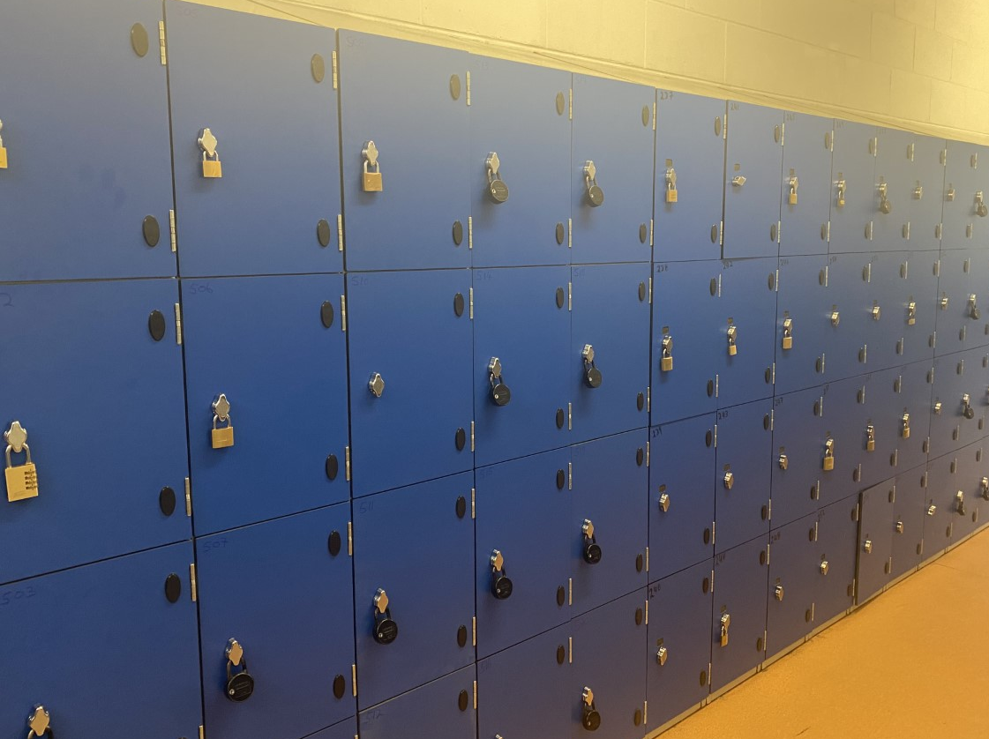
School Lockers
A locker is assigned to all students, after the school fees are paid in full.
Students must purchase a lock for their locker, Diamond's Hardware, Kiltimagh supply locks suitable for our lockers.
If a student loses their locker key, they may contact either Aiden or Brendan, who will cut the lock off the locker.
It is important that students change their books at break and lunch time, to avoid their schoolbags being too heavy.

Slide 12
Year Head
The 1st Yr Year Head for the 2025-2026 academic year will be Ms. Ruth McNamara.

Slide 13

PE Class
When you son or daughter have their PE class, they bring in their own PE gear and they change into it in the changing rooms.
We do not have a PE uniform.
Please ensure all items of clothing and footwear are clearly labelled.

Slide 14

After School Homework Club
If your child had an educational assessment, they may qualify for a place in the Homework club after school.
Some of the kind ladies in the Homework Club will help your son or daughter to complete their homework and they will get free fruit and a drink.
The Homework Club starts at 4.15pm and finishes at 5.30pm Monday to Thursday.
It is supervised by our team of Special Needs Assistants.
If would like your son or daughter to avail of this facility, please contact the school on 094 93 81228

Slide 15

After School Evening Study
Evening Study is available to all students from 4.15pm to 6.15pm, Monday to Thursday and 2.00pm to 4.00pm on Friday.
This is a quiet, study facility, students do not get help with their work.
There are costs involved in attending Evening Study.

Slide 16
If your Child feels Sick in school
If your child feels sick and they really cannot stay in school, they tell their class teacher that they don’t feel well, and they want to go home.
They gather their belongings, go the school office and tell Fiona or Imelda that they want to go home. They will ring a parent or guardian to collect them.
The student’s contact numbers are available on our school administration system.
A student cannot leave the school without their parents or guardians signing them out, and you must come into the school office to collect your child.

Slide 17
Additional Educational Needs Team.
Ms. Tracey Kenny (Additional Educational Needs Coordinator)
Ms. Heather Coleman
Ms. Mary Dunne
Ms. Louise McEvaddy
Please ensure all documentation, relevant to your child's additional needs, are submitted with the Enrolment form.

Slide 18
CAT 4 Tests
All 1st year students will be invited to sit the CAT 4(cognitive attainment tests) before they start 1st year.
These tests will help us to determine the students who may require additional support.
The results of the CAT 4 tests will be sent home after we have analysed the results.

Slide 19
Irish Exemptions
Students will only be permitted to join the Irish exempt class, after the official Irish exemption certificate has been processed.
Students who are not studying Irish will receive either literacy or numeracy support.
Please contact Ms. Tracey Kenny if your son or daughter has an Irish exemption.
tracey.kenny@stlouiscs.com

Slide 20

Junior Cycle Schools Programme
The Junior Certificate School Programme (JCSP) operates within the Junior Cycle curriculum.
It is an intervention into the Junior Cycle and not an alternative to it.
It helps to make the curriculum accessible and relevant to young people who would benefit from a different approach to the Junior Cycle.

Slide 21
The JCSP approach involves:​
analysing students’ strengths and weaknesses and taking note of any specific recurring difficulties.​
planning programmes of work which both build on students’ abilities and address the main obstacles which hinder their progress.​
engaging in dialogue with young people and their parents regarding their needs and their progress in school​.
Ms. Andrea Maloney and Mr. Sean Costello are the Junior Cycle Coordinators.

Slide 22
School Layout
Our school is basically a square on four different levels, with a piece built onto it.
Your child will have a room number on their timetable and within a few days they will have figured out exactly where there are going and how they are going to get there.
If their class is on the second floor, then the room number on the timetable will say 2-113, the first number is always the floor level.

Slide 23
Homework Journals
•Students are asked to have their School Journals with them for every class period to record their homework.
•Parents are asked to check that their son / daughter is completing their homework and to sign the Homework Journal.
•The School Journal is to be used only for the recording of homework, and communication between parents/guardians and the school.
We ask students to keep their journals in good condition and free from graffiti.
it must be maintained in a clean condition, free from graffiti etc.
•The loss of a School Journal, or defacing or removing of Journal pages is a serious matter. Where this arises students must present a written explanation of same, signed by parents/guardians, and may be required to purchase a replacement School Journal.

Slide 24

Non-Uniform Days
Occasionally, we organise non-uniform days in aid of local charities.
Students are permitted to wear their own casual clothes on days like these.
Parents will be notified of such days.

Slide 25

School Bags
Schoolbags are extremely heavy in secondary school, if
students don’t use their lockers wisely.
All of our classes are one hour in duration, so the students have a maximum of six subjects in a day. When they come into school in the morning, they should go to your locker and put all of their books into it, except the books that are required for the first two classes.
At break time students should put the books from the first two classes into their locker and take out the books for the next two classes.
After they have eaten their lunch, they should put the books they had for classes 3 and 4 into their locker and take out the books they require for the last two classes.

Slide 26

Homework
When the students are going home, they should bring home all the books for the subjects in which they have been assigned homework.
They may not get homework in all of their subjects, as we try to ease them in gently with the homework.
It is very important that the students record all of their homework in their homework journal.

Slide 27
Lost Property
All items of clothing and belongings should be clearly labelled.
If property is lost or mislaid, the student should contact Aiden or Brendan.

Slide 28
Changing Subjects
If your son or daughter wants to change their optional subjects, please take the following steps;
The student must make an appointment with Ms. Ruane, she will check the class sizes and see if there is a space available, then she will discuss the implications of the subject change.
The student must bring in a note from their parents or guardians, granting permission to change subject and present it Mr. Cleary, who will make the change on Tyro.
She will also inform the relevant subject teachers and the Book Rental coordinator.

Slide 29
Mobile Phones
Mobie phones must be turned off and out of sight at all times. If a student is found with, or using their mobile phone, it is confiscated until Friday after school, and their parents or guardians must come into the school office to collect it.
Please see our mobile phone policy on the school website, for more details.
www.stlouiscs.com
Our School
Policies.

Slide 30

Book Rental Scheme
The textbooks and stationery will be distributed to all Junior Cycle students before they start school. An annual deposit is required, and this will be returned at the end of 3rd year, after all the books are returned to the school.
The books remain the property of St. Louis.
We expect our students to take good care of the books we lend them.

Slide 31
Pastoral Care Supports
If your child requires emotional support in school, please contact any of the following;
Name | Role | Email Address
Ms. Walburg Ruane | Guidance Counsellor | Walburg.ruane@stlouiscs.com
Ms. Trish O'Brien | Chaplain | Trish.obrien@stlouiscs.com
Ms. Tracey Kenny | Guidance Counsellor | Tracey.kenny@stlouiscs.com
Mr. Fearghal O'Hara | Support Teacher | Fearghal.ohara@stlouiscs.com
Ms. Mary Kilcoyne | Counsellor | Mary.kilcoyne@stlouiscs.com

Slide 32
Student Supports outside of School​
Venue | Service | Telephone Number
Mindspace | Mental Health Service | 086 1844995 0949367001
Knock Counselling Centre | Counselling service for 12-18 year olds. | 094 9375032
Family Centre, Castlebar | Counselling, Bereavement Support | 094 9025900
Pieta House, Tuam | Suicide and Self-Harm Crisis Centre. | 093 25586

Slide 33
Extra Curricular
Student Group | Coordinator
Chaplaincy Team | Ms. Trish O'Brien
Wellbeing Team | Ms. Walburg Ruane
Green Schools | Ms. Louise O'Hora
Year Book Committee | Ms. Mary Dunne
Student Council | Ms. Trish O'Brien
Prefects (6th year students only) | Ms. Nuala Whelan

Slide 34


Sport
There are many sporting opportunities available in St. Louis, students may join any of the following teams at Junior or Senior level.
Gaelic
Soccer
Volleyball
Basketball
Badminton
Athletics

Slide 35

Medical Issues
If your son or daughter has any medical issues, please inform us by telephoning 094 93 81228
A letter will be required from your doctor, detailing the medical condition and any prescribed medication.
A medical form will also have to be completed, via the school app.

Slide 36

The School App
The TYRO Schools App is our primary means of communicating with parents, we don’t send out any information by post.
To download this app, please take the following steps;
Access your Tyro email invitation and click on the link in the email that says 'Click here' to sign up.
Download the Tyro App in the App Store/Google Playstore.
Open the App, once installed and press 'Sign up' Button.
Enter your email and press 'Verify Code'.
Copy and paste in your code and press 'Verify Code'
Create your new password
Login to Tyro with your email and new password.

Slide 37
School Payments
All school payments can be made via the school app
Open the school app.
Click on your child's name.
The fees will appear in the heading at the top of the screen.
Please ensure all payments are paid in full before school commences.

Slide 38

Assessments
Students will have two sets of formal assessments at
Christmas and the end of the year, they will also have various class tests throughout the year.
Reports.
All student assessment reports will be available on the TYRO app under the Assessment tab.
If you have any difficulty accessing these reports, please contact the school office on 094 93 81228

Slide 39

Microsoft Office
All of our students will be set up with a Microsoft Office 365 account, and they will have access to Word, Excel, PowerPoint, OneNote, email and Teams.
Our ICT Acceptable Usage Policy is developed to safeguard the use of these facilities; it is available on the school website.
www.stlouiscs.com
Our School
Policies

Slide 40
School Uniform
Boys
Grey uniform shirt.
Wine uniform round neck jumper with crest.
Dark grey uniform trousers.
Black shoes or runners without coloured branding.

Slide 41
School Uniform
Girls
Navy v neck jumper with crest
Cream, cotton, uniform blouse worn with collar turned down.
Knee-length, pleated, check uniform skirt or navy uniform trousers.
Plain (not embellished), flat, completely black shoes.

Slide 42
Class Rules
In order to create a classroom environment which is conducive to learning and development, the following rules apply in the classroom:
The authority of the teacher in the classroom must be respected at all times.
Students must be on time for each class and have all materials required for class. Borrowing of books or other materials is prohibited.
Students must respect the right of their fellow students to work without hindrance or distraction. Disruptive or inappropriate behaviour is not permitted in the classroom.
An immediate apology is required for an offence caused to teacher or students in the classroom.
To answer a question or seek the attention of the teacher a student must raise a hand and wait for permission to speak.

Slide 43
Students must leave the classroom in an orderly manner when class is dismissed.
Written permission from a teacher, Year Head, Deputy Principal or Principal, is essential when a student is absent for a class or part of a class period.
The school uniform as stated in the School Journal must be worn at all times during the school day or when engaged in school activities.
A high standard of neatness and personal hygiene is expected of all students.
Mobile phones are not permitted in the school. If found they will be confiscated and returned to the parent/guardian of the student on Friday after school.
Interference of any kind with another person’s property, including school property, is a serious breach of the school’s code of Conduct. Students or their parents/guardians may be required by the school to pay for the repair or replacement of property damaged by students.
Items which are dangerous, inappropriate or a cause of distraction, are not permitted in the school and may be confiscated.
Chewing gum is strictly prohibited throughout the school and grounds of the school.

Slide 44

Procedures for Parent Teacher Meetings
All Parent Teacher Meetings will take place in the new building, in the Louis Bautain hall and the classrooms upstairs.
School will finish at the earlier time of 3.45pm on the afternoon of the Parent Teacher meetings. School buses will be notified of the early finishing time.
The meetings will take place between 4.15pm and 6.45pm
Please bring a biro and a list of your child's teachers with you.
Please make every effort to attend your child's
meeting.

Slide 45
Procedures for Students Leaving School Early
If your child has to leave school early, please give them permission to leave on the TYRO app, and present to the front office to collect your child. Students are not allowed to leave the school until their parent presents to the front office.
Procedures for Students arriving Late to School
If a student has an appointment and they are signing in late, parents may sign them in on the app, and the student must report to the front office where their late entry will be authorised. You do not need to accompany your child to the front office if they are signing in late.

Slide 46
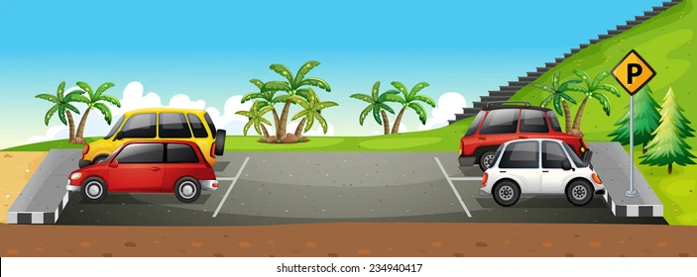
School Parking
Parking on school grounds is reserved for staff only.
If your child has a disability, please contact us and we will arrange for you to have access to a disabled parking place.

Slide 47
School Canteen
The canteen is open at break time and lunch time every day.
A sample lunch time menu is outlined below.
All the dinners cost €3.50
Chicken Curry Spaghetti Bolognese Pasta Carbonara Breaded chicken, veg and potatoes.

Slide 48
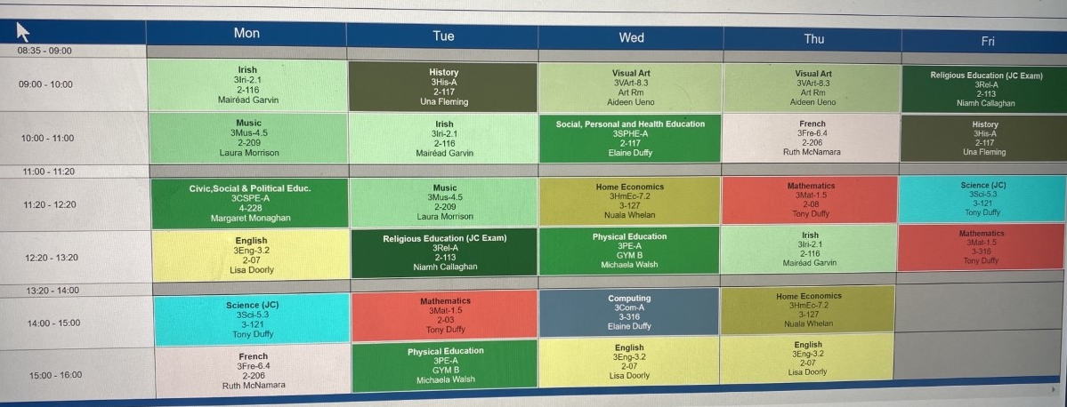
Sample Timetable

Slide 49
Le Cheile Nominees | Sr. Mary O’Connor Ms. Mary Mullarkey Mr. Michael Brett
ETB Nominees | Ms. Mary Madden Mr. Pat Forde Ms. Bernie Rowland
Staff Nominees | Mr. John Harrington Ms. Ruth McNamara
Parent Nominees | Ms. Liesel Ward Ms. Anne Marie Gilmore
The Board of Management is responsible for school governance, subject to the provisions of the Deed of Trust and the Education Act, 1998.

Slide 50
Contacting Teachers
All contact with our teaching staff must be by appointment only.
An appointment can be made by contacting the Administration Office on 094 94 81228

Slide 51

Contacting your Child during School Hours
Please ring the main office on
094 93 81228 to make contact with
your son or daughter.
Please do not contact them via their
mobile phone during the school day.

Slide 52
School Contact Details
Telephone; 094 93 81228
Email
Principal; Ms. Regina Anderson regina.anderson@stlouiscs.com
Deputy Principal; Mr. Grahame Cleary grahame.cleary@stlouiscs.com
Secretary; Ms. Imelda Reilly imelda.reilly@stlouiscs.com
Secretary; Ms. Yvonne Corley yvonne.corley@stlouiscs.com
Secretary; Ms. Fiona Byrne fiona.byrne@stlouiscs.com

Slide 53



Social Media
We have a Facebook, Twitter and Instagram page, please follow us on the various social media platforms to keep up to date with all the latest news.
Please find the links or handles below,
Facebook: St. Louis CS
Instagram: stlouiscs_mayo
Twitter: StLouisCS_Mayo

